Slide 1
Pension Fund Asset Risk Management
Monitoring market risk
Tony de Graaf
Principal Risk Manager

Slide 2
Disclaimer
All material contained herein is indicative and for discussion purposes only, is strictly confidential, may not be reproduced and is intended for your internal use only. This document has been solely prepared for discussion purposes and is not an offer, or a solicitation of an offer, to buy or sell any security or financial instrument, or any investment advice. This policy does not confer any rights to any third parties. PGGM Investments has taken all reasonable care to ensure that the information contained in this document is correct, but does not accept liability for any misprints. The information contained herein can be changed without notice.

Slide 3
Agenda
Trends in pension fund asset risk management
Pension fund balance sheet risk management
Asset risk measurement and attribution
Stress testing
AIFMD risk management measures

Slide 4
Trends in pension fund asset risk management
Pension fund boards want to be ‘in control’
Transparancy
Increasing interest in good execution, robust operations and countervailing power, less in ‘alpha’ skills
Understand what you invest in
Higher compexity must pay-off
Delegation may not lead to less control
Detailed monitoring of investment process
Detailed investment restrictions
  Between pension fund and asset manager
  Between asset manager and external managers
Awareness of liquidity risk and counterparty risk

Slide 5

Balance sheet risk management

Slide 6
Investment process
Pension liabilities
100% nominal discounted
ALM
30% equities
5% commodities
65% fixed income
50% interest rate hedge
SBM
15% equities
5% Private Equity
5% Listed Real Estate
5% Private Real Estate
5% Commodities
45% Government Bonds
10% Credits
5% High Yield
5% Local Ccy Bonds
70% Currency hedge
Implementation
3.000 stocks
500 bonds
20 commodity futures
Asset swaps
Interest Rate Swaps
Cross currency swaps
Etc.

Slide 7
Balance sheet risk monitoring
Investment Process | Risk Measurement |  | Stress scenarios
 |  |  | Black Monday 1987 | Credit crisis 2008
Balance sheet risk | SaR / CRaR 1 month | CR risk 1 year
Pension Reserve vs. ALM | 7.0 mln / 1.7% | 8.3% | -3.3% | -3.4%
Pension Reserve vs. SBM | 9.9 mln / 2.1% | 11.7% | -3.7% | -8.5%
Pension Reserve vs. Implementation | 9.6 mln / 2.0% | 11.3% | -3.6% | -8.3%
Allocation risk | RVaR / TE | Tracking error
ALM vs. SBM | 6.9 mln / 1.2% | 4.2% | -0.4% | -5.1%
ALM vs. Implementation | 6.6 mln / 1.1% | 4.2% | -0.3% | -4.9%
Implementation risk
Implementation risk (liquid assets) | 0.5 mln / 0.1% | 0.3% | 0.1% | 0.2%

Slide 8
Coverage Ratio at Risk (CRaR)

Slide 9
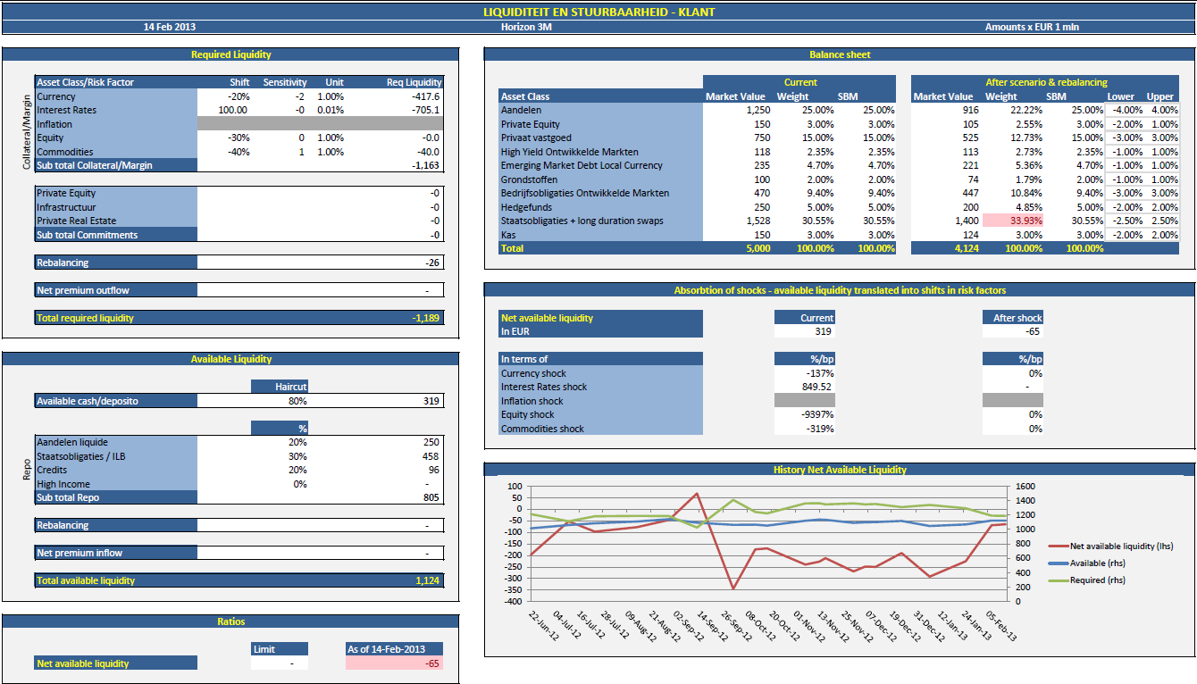
Monitoring liquidity and controllability

Slide 10

Asset risk measurement and attribution

Slide 11
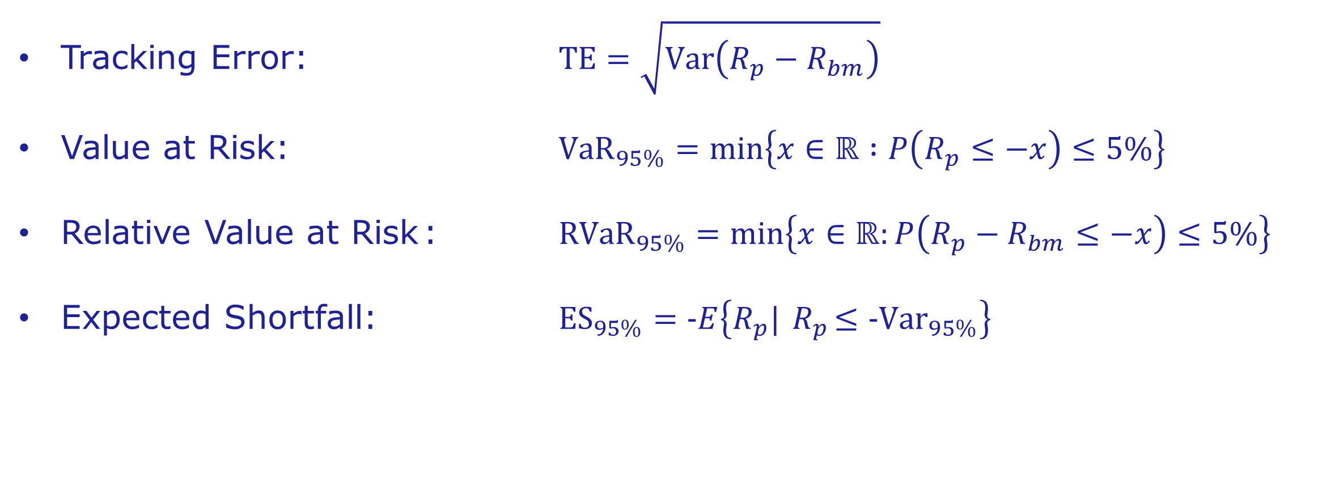
Popular asset risk measures
Tracking Error: $\text{TE}=\sqrt{\text{Var}\left(R_{p}−R_{bm}\right)}$
Value at Risk: ${\text{VaR}}_{95\%}=\text{min}\left\{x∈ℝ :P\left(R_{p}≤−x\right)≤5\%\right\}$
Relative Value at Risk : ${\text{RV}\text{aR}}_{95\%}=\text{min}\left\{x∈ℝ:P\left(R_{p}−R_{bm}≤−x\right)≤5\%\right\}$
Expected Shortfall: ${\text{ES}}_{95\%}=\text{−}E\left\{R_{p}|{ R}_{p}≤{\text{−}\text{Var}}_{95\%}\right\}$

Slide 12
Considerations
Forward looking period (day, month, year)
Backward looking period (months, year, multiple years)
Ex-ante or ex-post
Static vs dynamic portfolio (reinvestments?)
Historical returns frequency (1D, 3D, 5D, 21D)
Weighting scheme for historical returns
(equal, decay factor, long memory)
Overlapping vs. non-overlapping returns
Returns distribution
Dependence structure (standard multivariate distribution, copula)
Parametric vs. Monte Carlo

Slide 13
Risk attribution
Static vs. dynamic
Allocation versus selection effect
(similar to performance attribution)
Breakdown according to the fund
management process
  Countries
  Sectors
  Instrument types
Risk type
  Interest rate, spread, FX, …
  Maturity segments
  Equity factors
Portfolio Return
Benchmark Return
Active Return
Currency Effect
Allocation Effect
Selection Effect
Specific Return
Common Factor
Industry
Style

Slide 14
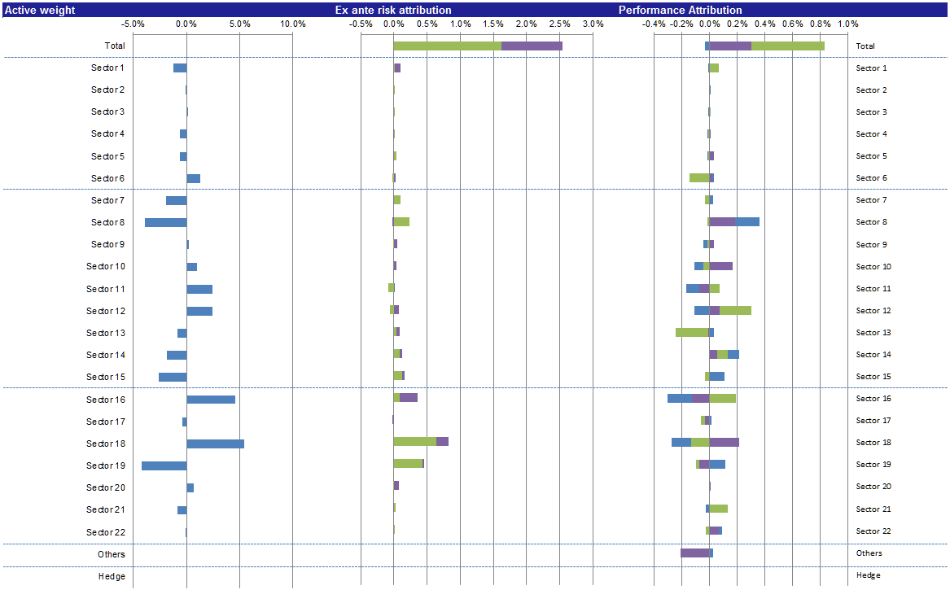
PGGM example

Slide 15
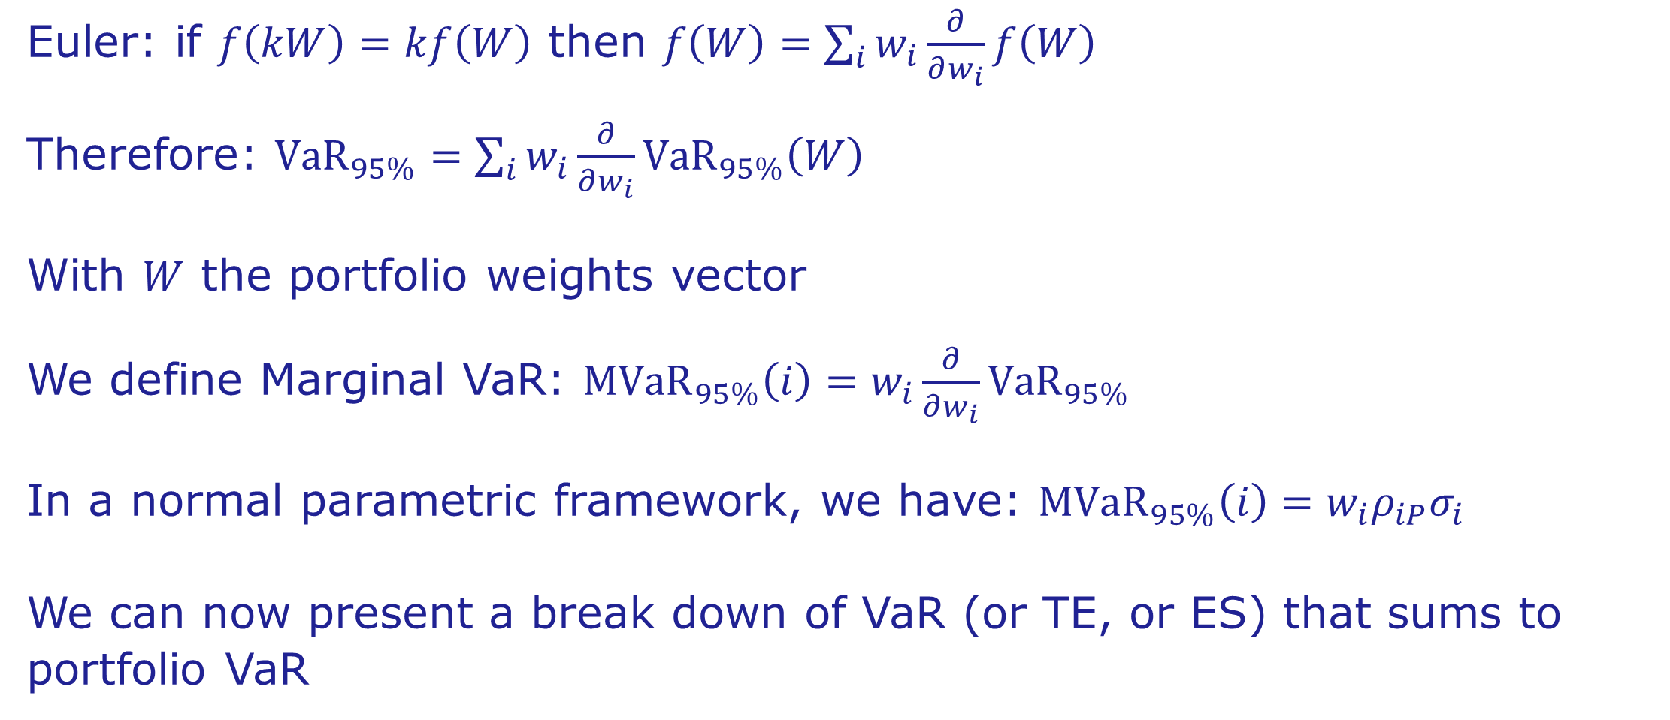
Classical risk attribution
Euler: if $f\left(kW\right)=kf\left(W\right)$ then $f\left(W\right)=\sum_{i}{w_{i}\frac{∂}{∂w_{i}}f\left(W\right)}$
Therefore: ${\text{VaR}}_{95\%}=\sum_{i}{w_{i}\frac{∂}{∂w_{i}}{\text{VaR}}_{95\%}\left(W\right)}$
With $W$ the portfolio weights vector
We define Marginal VaR: ${\text{MV}\text{aR}}_{95\%}\left(i\right)=w_{i}\frac{∂}{∂w_{i}}{\text{VaR}}_{95\%}$
In a normal parametric framework, we have: ${\text{MVaR}}_{95\%}\left(i\right)={w_{i}ρ}_{iP}σ_{i}$
We can now present a break down of VaR (or TE, or ES) that sums to portfolio VaR

Slide 16
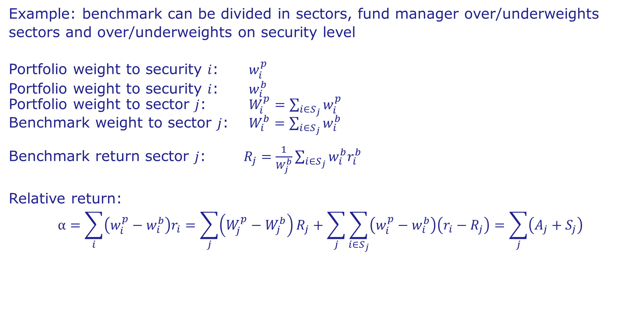
Incorporating allocation and selection effect in TE
Example: benchmark can be divided in sectors, fund manager over/underweights sectors and over/underweights on security level
Portfolio weight to security $i$: $w_{i}^{p}$
Portfolio weight to security $i$: $w_{i}^{b}$
Portfolio weight to sector $j$: $W_{i}^{p}=\sum_{i∈S_{j}}{w_{i}^{p}}$
Benchmark weight to sector $j$: $W_{i}^{b}=\sum_{i∈S_{j}}{w_{i}^{b}}$
Benchmark return sector $j$: $R_{j}=\frac{1}{W_{j}^{b}}\sum_{i∈S_{j}}{w_{i}^{b}r_{i}^{b}}$
Relative return:
$$α=\sum_{i}{\left(w_{i}^{p}−w_{i}^{b}\right)r_{i}=\sum_{j}{\left(W_{j}^{p}−W_{j}^{b}\right)}}R_{j}+\sum_{j}{\sum_{i∈S_{j}}{\left(w_{i}^{p}−w_{i}^{b}\right)\left(r_{i}−R_{j}\right)}}=\sum_{j}{\left(A_{j}+S_{j}\right)}$$

Slide 17
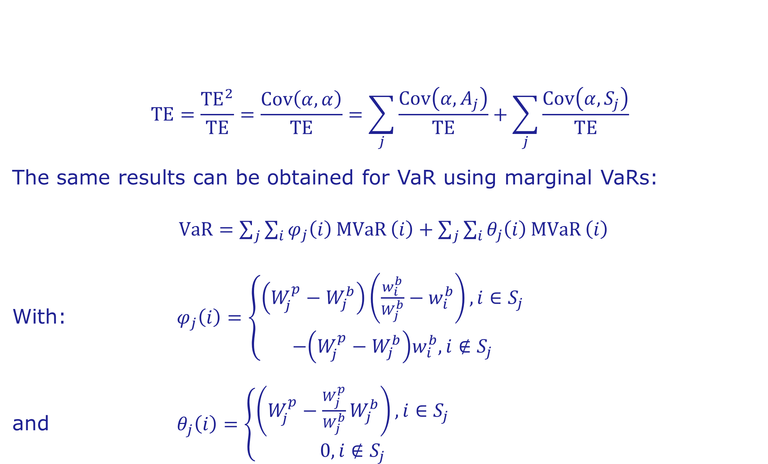
Incorporating allocation and selection effect in TE (2)
$$\text{TE}=\frac{{\text{TE}}^{2}}{\text{TE}}=\frac{\text{Cov}\left(α,α\right)}{\text{TE}}=\sum_{j}{\frac{\text{Cov}\left(α,A_{j}\right)}{\text{TE}}}+\sum_{j}{\frac{\text{Cov}\left(α,S_{j}\right)}{\text{TE}}}$$
The same results can be obtained for VaR using marginal VaRs:
$\text{VaR}=\sum_{j}{\sum_{i}{φ_{j}\left(i\right)}\text{MVaR}}\left(i\right)+\sum_{j}{\sum_{i}{θ_{j}\left(i\right)}\text{MVaR}}\left(i\right)$
With: $φ_{j}\left(i\right)=\left\{\begin{aligned}\left(W_{j}^{p}−W_{j}^{b}\right)\left(\frac{w_{i}^{b}}{W_{j}^{b}}−w_{i}^{b}\right), i∈S_{j} \\ −\left(W_{j}^{p}−W_{j}^{b}\right)w_{i}^{b}, i∉S_{j}\end{aligned}\right.$
and $θ_{j}\left(i\right)=\left\{\begin{aligned}\left(W_{j}^{p}−{\frac{W_{j}^{p}}{W_{j}^{b}}W}_{j}^{b}\right), i∈S_{j} \\ 0, i∉S_{j}\end{aligned}\right.$
See RiskMetrics working paper ‘Risk attribution for asset managers’ by Jorge Mina (2002)

Slide 18
Dynamic risk attribution
Asset | MW | Vol(%) | Correlations
1 | 30 | 10% | 1.0 | 0.5 | 0.5 | 0.5
2 | 40 | 15% | 0.5 | 1.0 | 0.5 | 0.5
3 | 30 | 20% | 0.5 | 0.5 | 1.0 | 0.5
4 | 10 | 15% | 0.5 | 0.5 | 0.5 | 1.0
Asset | MW | Vol(%) | Correlations
1 | 30 | 15% | 1.0 | 0.6 | 0.5 | 0.4
2 | 45 | 25% | 0.6 | 1.0 | 0.5 | 0.7
3 | 30 | 20% | 0.5 | 0.5 | 1.0 | 0.5
4 | 15 | 10% | 0.4 | 0.7 | 0.5 | 1.0
As per the start (above) and end (below) of the analysis period

Slide 19
Dynamic risk attribution (2)
Asset | VaR (t=0) | MVaR (t=0) | VaR (t=1) | MVaR (t=1) | ΔMVaR
1 | 4.94 | 3.61 | 7.40 | 5.65 | 2.04
2 | 9.87 | 8.33 | 18.51 | 17.13 | 8.80
3 | 9.87 | 8.33 | 9.87 | 7.42 | -0.91
4 | 2.47 | 1.67 | 2.47 | 1.80 | 0.13
 | 21.93 | 21.93 | 32.00 | 32.00 | 10.07
Asset 3 has a larger impact on ΔMVaR then asset 4, although the parameters for asset 3 didn’t change
Attribution cannot be broken down into single parameters

Slide 20
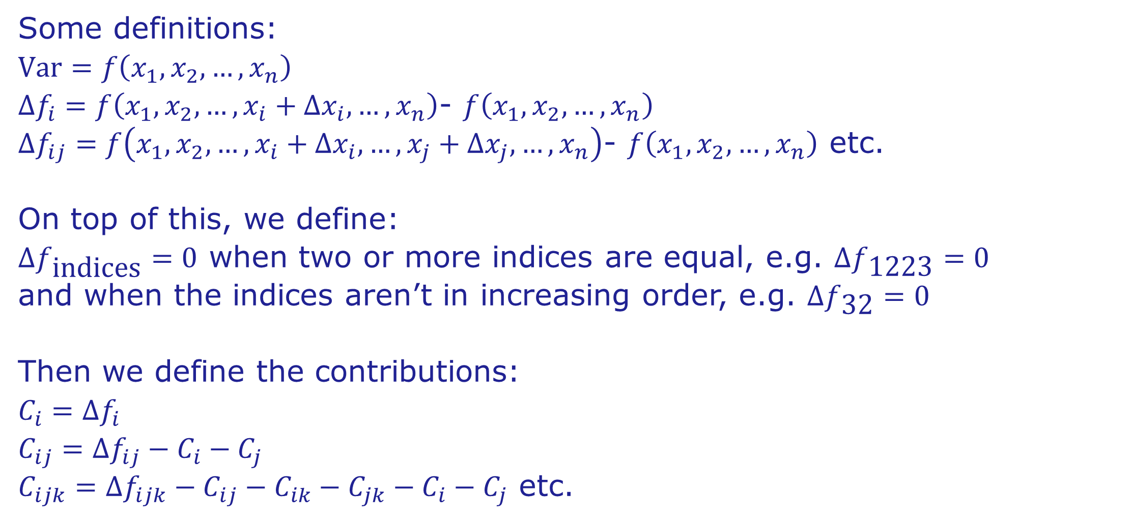
New method for dynamic risk attribution
Some definitions:
$$\text{Var}=f\left(x_{1},x_{2},…,x_{n}\right)$$
$∆f_{i}=f\left(x_{1},x_{2},…,x_{i}+∆x_{i},…,x_{n}\right)$- $f\left(x_{1},x_{2},…,x_{n}\right)$
$∆f_{ij}=f\left(x_{1},x_{2},…,x_{i}+∆x_{i},…,x_{j}+∆x_{j},…,x_{n}\right)$- $f\left(x_{1},x_{2},…,x_{n}\right)$ etc.
On top of this, we define:
$∆f_{\text{indices}}=0$ when two or more indices are equal, e.g. $∆f_{\text{1223}}=0$
and when the indices aren’t in increasing order, e.g. $∆f_{\text{3}\text{2}}=0$
Then we define the contributions:
$$C_{i}=∆f_{i}$$
$$C_{ij}=∆f_{ij}−C_{i}−C_{j}$$
$C_{ijk}=∆f_{ijk}−C_{ij}−C_{ik}−C_{jk}−C_{i}−C_{j}$ etc.

Slide 21
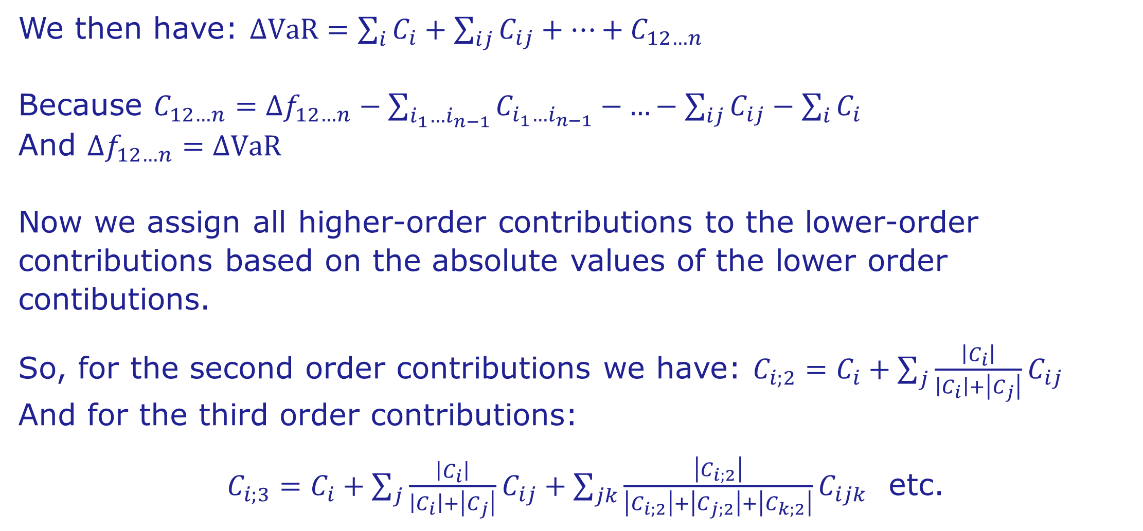
New method for dynamic risk attribution (2)
We then have: $∆\text{Va}\text{R}=\sum_{i}{C_{i}}+\sum_{ij}{C_{ij}+…+C_{12…n}}$
Because $C_{12…n}=∆f_{12…n}−\sum_{i_{1}…i_{n−1}}{C_{i_{1}…i_{n−1}}−}…−\sum_{ij}{C_{ij}}−\sum_{i}{C_{i}}$
And $∆f_{12…n}=∆\text{VaR}$
Now we assign all higher-order contributions to the lower-order contributions based on the absolute values of the lower order contibutions.
So, for the second order contributions we have: $C_{i;2}=C_{i}+\sum_{j}{\frac{\left|C_{i}\right|}{\left|C_{i}\right|+\left|C_{j}\right|}C_{ij}}$
And for the third order contributions:
$C_{i;3}=C_{i}+\sum_{j}{\frac{\left|C_{i}\right|}{\left|C_{i}\right|+\left|C_{j}\right|}C_{ij}}+\sum_{jk}{\frac{\left|C_{i;2}\right|}{\left|C_{i;2}\right|+\left|C_{j;2}\right|+\left|C_{k;2}\right|}C_{ijk}}$ etc.

Slide 22
New method for dynamic risk attribution (3)
Parameter | Value (t=0) | MVaR (t=0) | 1st order contribution | 2nd order contribution | 3rd order contribution | ≥4th order contribution | ΔMVaR
MW 1 | 30.00 | 30.00 | 0.00 | 0.00 | 0.00 | 0.00 | 0.00
MW 2 | 40.00 | 45.00 | 1.05 | 0.15 | 0.00 | 0.00 | 1.20
MW 3 | 30.00 | 30.00 | 0.00 | 0.00 | 0.00 | 0.00 | 0.00
MW 4 | 10.00 | 15.00 | 0.85 | -0.14 | 0.00 | 0.00 | 0.70
Vol 1 | 0.10 | 0.15 | 1.86 | 0.00 | 0.01 | 0.00 | 1.88
Vol 2 | 0.15 | 0.25 | 5.78 | 0.77 | 0.04 | -0.01 | 6.58
Vol 3 | 0.20 | 0.20 | 0.00 | 0.00 | 0.00 | 0.00 | 0.00
Vol 4 | 0.15 | 0.10 | -0.55 | -0.15 | 0.00 | 0.00 | -0.69
Cor 1x2 | 0.15 | 0.60 | 0.22 | 0.01 | 0.00 | 0.00 | 0.23
Cor 1x3 | 0.50 | 0.50 | 0.00 | 0.00 | 0.00 | 0.00 | 0.00
Cor 1x4 | 0.50 | 0.40 | -0.06 | 0.00 | 0.00 | 0.00 | -0.06
Cor 2x3 | 0.50 | 0.50 | 0.00 | 0.00 | 0.00 | 0.00 | 0.00
Cor 2x4 | 0.50 | 0.70 | 0.22 | 0.00 | 0.00 | 0.00 | 0.22
Cor 3x4 | 0.50 | 0.50 | 0.00 | 0.00 | 0.00 | 0.00 | 0.00
 |  |  | 9.38 | 0.64 | 0.05 | -0.01 | 10.07

Slide 23
New method for dynamic risk attribution (4)
Asset | VaR (t=0) | VaR (t=1) | Average VaR | Attribution
1 | 4.94 | 7.40 | 6.17 | 1.91
2 | 9.87 | 18.51 | 14.19 | 8.13
3 | 9.87 | 9.87 | 9.87 | 0.00
4 | 2.47 | 2.47 | 2.47 | 0.03
 |  |  |  | 10.07
Compare with attribution based on MVaR!
Drawback: computationally intensive
See article in “De Actuaris” by Tony de Graaf (2012)

Slide 24
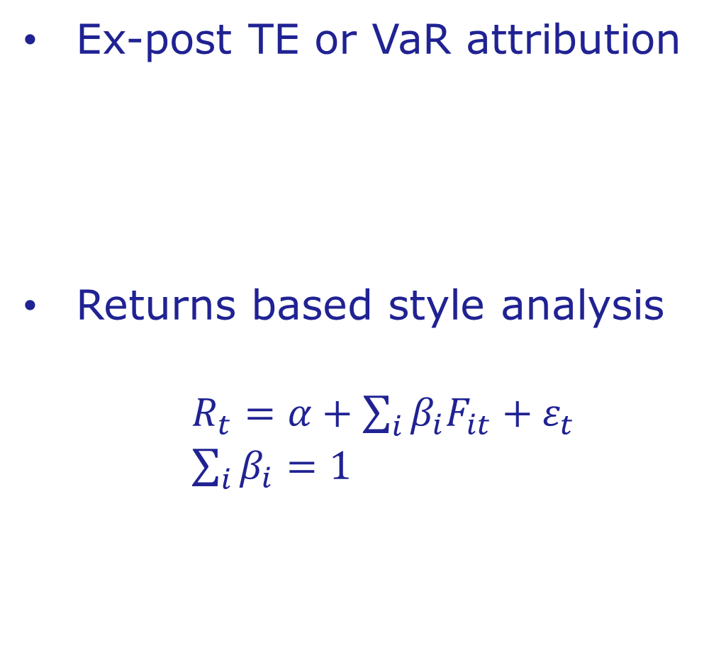
Returns based risk measurement
Ex-post TE or VaR attribution
Returns based style analysis
$R_{t}=α+\sum_{i}{β_{i}F_{it}}+ε_{t}$
$\sum_{i}{β_{i}}=1$

Slide 25

Stress testing

Slide 26
Stress testing for asset managers
Applicable at instrument level
Methodology must be sensitive to all instrument characteristics
Only key risk drivers need to be specified
Secondary risk drivers must follow in a consistent manner
Results should reflect current market sensitivities and dependencies

Slide 27
The predictive stress test
If and ,
then:
with:
This gives:
In a normal framework, this amounts to multivariate linear regression.
See article ‘Stress Testing in a Value at Risk Framework’ by Paul Kupiec (1998)

Slide 28
The predictive stress test
Each instrument is valued as a function of its risk factors:
Determine sensitivites of the risk drivers to the specified scenario factors:
The sensitivities depend on market volatilities and correlations, simple linear regression gives the approximation:
Varying the estimation period, one can get anything from a structural relation to a short-term trend

Slide 29
Predictive stress test example
Scenario: Credit Crisis 2008 H2
Specified in scenario S&P 500 and USD
In this example, S&P 500 loses 29% and USD gains 13% (against EUR)
Betas estimated over an 8-year period, using weekly returns

Slide 30
Predictive stress test example (2)
Risk factor | Volatility
S&P 400 | 20.5%
EPRA/NAREIT US | 28.4%
GSCI SPOT | 26.6%
GBP in EUR | 7.6%
S&P 500 | 17.7%
USD in EUR | 10.4%
Volatilities
 | S&P 400 | NAREIT | GSCI | GBP | S&P 500 | USD
S&P 400 | 1 | 0.78 | 0.31 | 0.08 | 0.95 | -0.24
NAREIT |  | 1 | 0.25 | 0.03 | 0.75 | -0.25
GSCI |  |  | 1 | 0.07 | 0.26 | -0.36
GBP |  |  |  | 1 | 0.07 | 0.36
S&P 500 |  |  |  |  | 1 | -0.22
USD |  |  |  |  |  | 1
Correlations

Slide 31
Predictive stress test example (3)
Factor | Stress
S&P 400 | -33%
EPRA/NAREIT US | -38%
GSCI Spot | -19%
GBP in EUR | +2%
Compare with:
Factor | Stress
S&P 400 | -34%
EPRA/NAREIT US | -37%
GSCI Spot | -60%
GBP in EUR | -18%
Factor | Stress
S&P 500 | -29%
USD in EUR | +13%
Predicted results
Scenario
Factor | Stress
S&P 400 | -39%
EPRA/NAREIT US | -45%
GSCI Spot | -24%
GBP in EUR | +3%
2008 H2 realisation

Slide 32
AIFMD
    Mandatory for non-UCITS investment funds
    Gross & commitment leverage
    Fund liquidity
      Regular measurement
      Stress test

