Slide 1
Stress tests A theoretical exercise or do they really work?
TopQuants Autumn Event 2013
By Robert Daniels
Partner at Capstone Financial Industry

Slide 2
Agenda
Stress tests - where do we stand?
Parameter, model and framework risks
Constructing firm-wide stress tests
Q&A
Statements (for discussion)

Slide 3
1. Stress tests - Where do we stand?
Methodology
Sensitivity analysis
Scenario analysis
Reverse tests
Firm-wide tests
Market
Credit
Counterparty
Risk types
Operational
Solvency
Liquidity
Strategy
Revenues
Costs
….
Firm-wide stress tests are still in development stage

Slide 4
Agenda
Stress tests - where do we stand?
Parameter, model and framework risks
Constructing firm-wide stress tests
Q&A
Statements (for discussion)

Slide 5
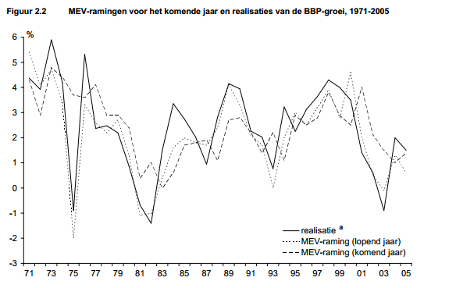
2. Macro-economic scenario analysis
Typical description
What about predictive power of macro economic models?
GDP realized (solid line) vs. forecasted
Relation between macro economic variables is weak under normal market circumstances.
…… But poor under macro economic stress

Slide 6
2. Consequences in stress periods …
Realized loss
Loss
Estimated loss
using macro-economic and risk models
Normal market
Stress environment
Realized losses are often much larger than envisaged due to
Hidden optionalities
Non-linearities
Behavior of markets and market participants
Notes:
Market liquidity
Forgotten/embedded options
Hidden contractual optionalities (e.g. not all legal data is being captured by systems)
Public pressure
Market reaction after large event
Reaction is often it was a four, six or 12 sigma event, but actually the underlying dynamics is not captured well

Slide 7
2. Parameter and framework risk Example: Stress testing mortgage portfolios
Basel II formula for mortgages
Key assumptions
Risk parameters are uncorrelated
Asset correlation parameter is constant; through time and across risk categories
Typical stress test
RWA = $EAD∗12.5∗LGD∗\left[{PD}_{stress}−PD\right]$
$${PD}_{Stress}=N\left[\left(1−R\right)^−0,5∗N^{−1}\left(PD\right)+\left(R/\left(1−R\right))^0,5∗N^{−1}\left(0,999\right)\right)\right]$$
$$Asset correlation \left(R\right)=0,15$$
$$PD=α_{0}+α_{1}GDP+α_{2}interest rates+…$$
$$LGD= β_{0}+β_{1}GDP+β_{2}housing prices+…$$

Slide 8
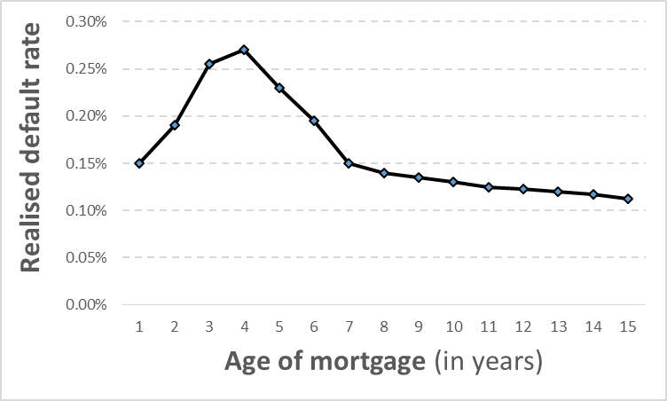
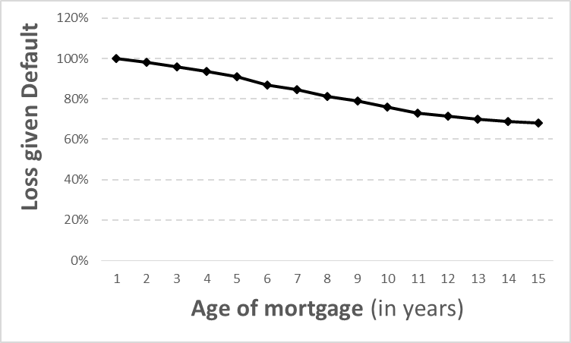
2. Parameter and framework risk Example: Stress testing mortgage portfolios
But are risk parameters independent? What about aging effects?
In practice there are correlations between risk parameters, but are they incorporated in the capital / stress test framework?

Slide 9
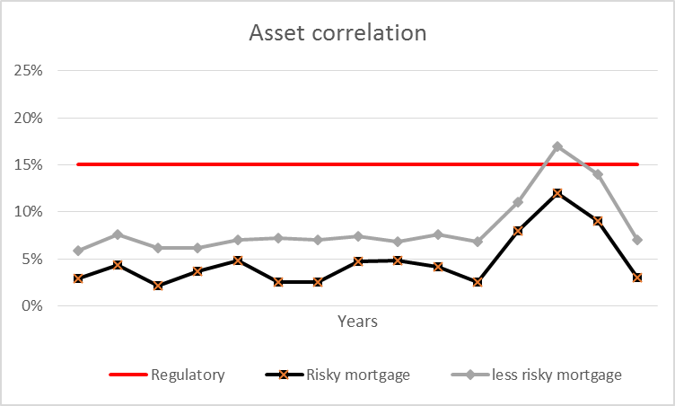
2. Parameter and framework risk Example: Stress testing mortgage portfolios
And to what extent are parameters time (in)variant?
Key framework assumptions are often not assessed when performing stress tests

Slide 10
2. EBA stress test framework - observations
Regulator has a challenging task
Maintain level playing field while institutions use internal models
Different risks, portfolios and risks across institutions
Yet, to what extent is the framework credible?
Identifying and measuring vulnerabilities in the trading environment
Regulatory scenarios lead to model optimization and become “anticipated”
Taking into account the dynamics of financial markets and market behavior
Implicit introduction of a new minimum required solvency ratio (before stress)
New reference
Average impact stress tests
Stress (core) tier 1 limit
Before stress
After stress

Slide 11
Agenda
Stress tests - where do we stand?
Parameter, model and framework risks
Constructing firm-wide stress tests
Q&A
Statements (for discussion)

Slide 12
3. Understand own balance sheet…
Take balance sheet, its dynamics and risk appetite as a starting point
Business/strategy
New Volume
Renewals
AuM
Margins
Impact on volume and margin
Profit & Loss
Balance sheet
Impact on Income
Impact on Liquidity profile
NII
Commisions
Fees
…
….
Trading
Savings
AFS
Debt
Loans
Impact on Solvency position
Other
Equity

Slide 13
3. Understand events that could trigger crisis
Institution (Micro)
Value of assets
Counterparties ability to pay
Collateral requirements
Revenues decrease
Depositors reluctant
Hidden optionalities in contracts
Impact other parts balance sheet
Trigger event
For example
Oil crisis
Over-leveraging
War
Natural disaster
USD confidence crisis
Financial markets
Exchange and interest rates
Liquidity of markets
Counterparties in difficulty
Overall confidence
Economy (Macro)
GDP, Housing prices, unemployment
Producer / consumer confidence
(In)ability central banks / politicians to act

Slide 14
3. Construct multi-stage stress scenarios
Trigger event
Direct impact
Economy (Macro)
Financial markets
Institution (Micro)
2nd order effects
Economy (Macro)
Financial markets
Institution (Micro)
3rd order effects
Economy (Macro)
Financial markets
Institution (Micro)

Slide 15
3. Constructing stress tests
Identifying events that could have a severe impact
Assess impact of events
Impact on P&L, capital position, balance sheet and business model
Effect on macro economy and financial markets
Review possible risk mitigants
Reduction of risk by means of hedges
Necessity to adjust obligations to clients and investors
Reduction of certain investments
Recognise that markets and institutions are inherently unstable and that nonlinearity under stress has a large impact

Slide 16
3. Current challenges
Scenarios construction
Good understanding is required of
How the balance sheet reacts to events
Macro economic developments and financial markets
Knowledge on vulnerabilities are widespread across organisations
Taking into account interaction between risk drivers and parameters
Outcome
Difficult to make results actionable
Timely take action if event develops
Stress testing becomes too much a routine

Slide 17
Agenda
Stress tests - where do we stand?
Parameter, model and framework risks
Constructing firm-wide stress tests
Q&A
Statements (for discussion)

Slide 18
4. Q&A
“Oh my God, today I had a loss that’s a six sigma event! I mean that’s the first time that’s happened in three months!”
It’s like a one in ten-thousand-year event, and I haven’t had one in the last three months.
Interview with a Hedge Fund Manager

Slide 19
Agenda
Stress tests - where do we stand?
Parameter, model and framework risks
Constructing firm-wide stress tests
Q&A
Statements (for discussion)

Slide 20
5. Statements (for discussion)
Assigning probabilities to outcomes of stress events are a useful management tool
Black swans and 6 sigma event explanations are the best reasons of why models did not work….. Otherwise I will have to explain to many details to sr mgt
Stress tests of the EBA provide a false sense of security
It is better to use simple scenario analysis and complex firm-wide stress tests than to a combination of macro-economic and risk models
Use stress parameters to calculate new capital requirements leads to double counting and overestimation of “true” risks
Financial institutions by definition will underestimate the risks of a certain scenario….
…….… and regulators by definition will overestimate the risks

